Slide 1
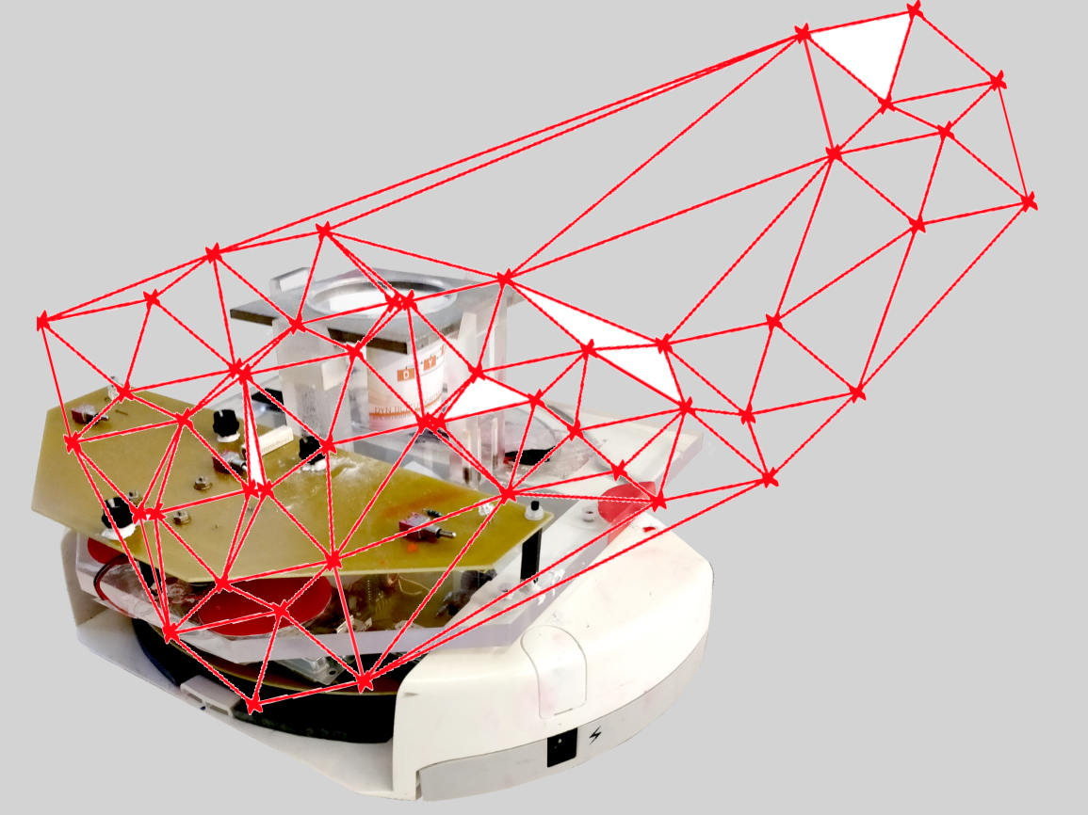
Project group SS18
Development of local positioning system for a pipe-less plant

Slide 2
Agenda
Introduction
Organization and workflow
Motivation and selection process
Radio-frequency identification
Simulation
Implementation
Demonstration
Conclusions and future work

Slide 3


Team & Organisation
Stefan
Software
Abdulrahman
Communication
Hardware Setup
Ordering Components
WiFi & RFID Programming
Stephan
Project Leader
Simulation
Ordering Components
Medhini
Existing setup
Communication
Hardware

Slide 4
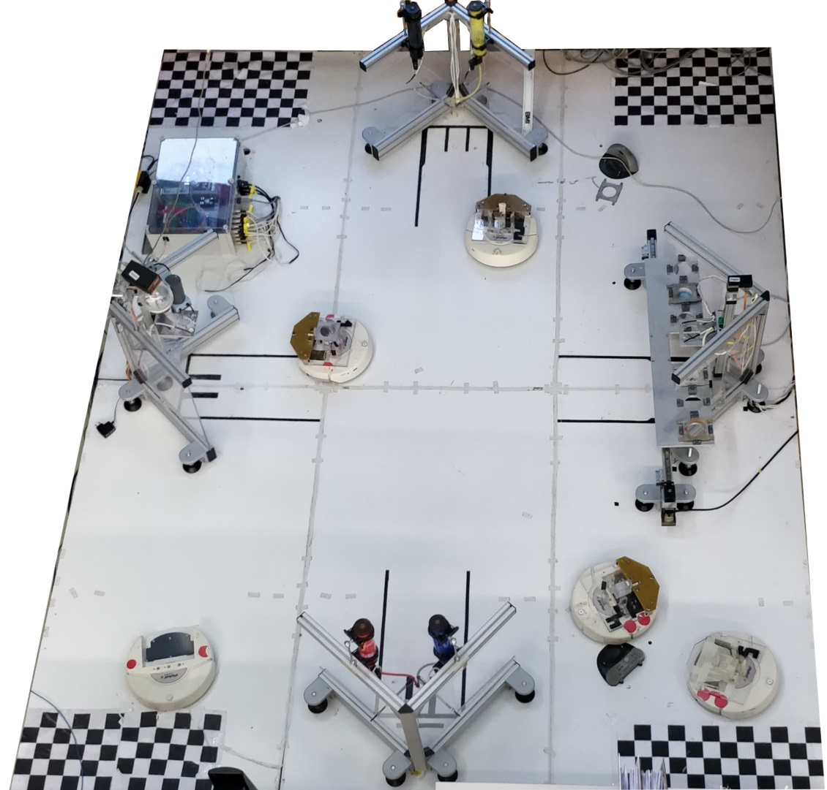
DYN Miniature Pipeless plant
General setup[3x4m]
4 AGVs
2 Color Stations
1 Mixing Station
1 Storage Station
Localization
1 Camera
LED pattern on AGV
Notes:
+ 1 slide camera ..+positoning system

Slide 5
Project objective
Research about alternative positioning system
Evaluate with simulation
Ultimate goal: improve positioning precision
Compare and develop practical proof of concept

Slide 6
Project motivation
Precise localization in any light conditions
Achieve low processing time
Ability to localize multiple robots
Develop a system without space limitation
Notes:
Working in all conditions

Slide 7
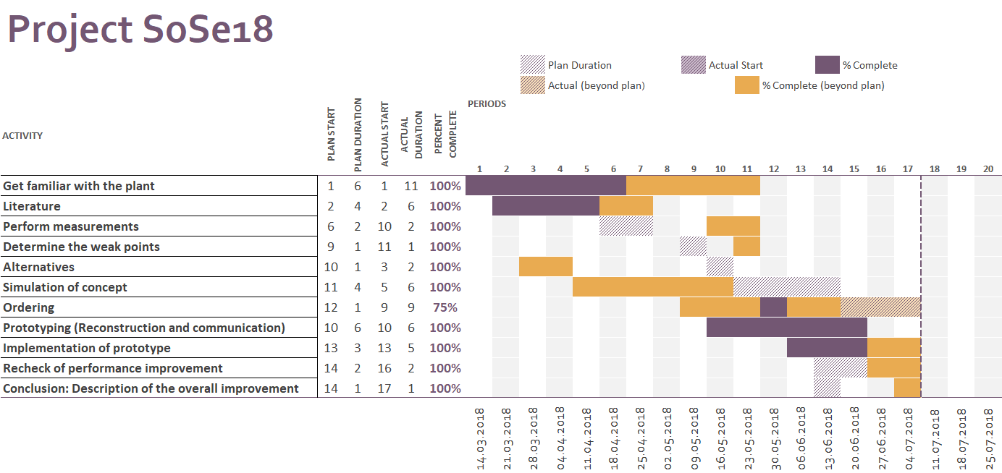
Project Workflow

Slide 8
Selection Process
Triangulation Method
Light dependant
Limited space
Pattern Recognition
Complex and cost intensive
Map-Based Localization
Drawbacks of multiple ultrasonic sensors
Radio-frequency identification
Light independent
Not space limited
Common concept of indoor localization

Slide 9

RFID (Radio Frequency Identification)
Object
Reader
RFID Tag
Radio Waves
Notes:
Technology works on sending radio frequency or radio waves. So this technology used to automatically identify or tracking an object. So RFID tag should be attached to the object, which wanted to be tracked. And the reader is continuously sending the radio waves. So when the tag is with in reader range, the tag start sending back feedback signal to the reader. And can track multiple objects in the same time

Slide 10
RFID System
RFID
Tags
Active
Passive
Reader
Semi-Passive
Notes:
Active: has own power supply, passive: don’t has and relies on the radio waves which come from the reader for the source of energy, semi: has power supply but for transmitting the feedback signal it relies on the signal coming from reader. So the rate of passive is less

Slide 11
RFID Reader
RFID Signal Generator
Microcontroller
Receiver / Signal Detector
Notes:
Generator: which generates the radio waves. And to receive signal coming back from tag, uses rec. or detector. While to process the information which are sent by the rfid or received from the tag.

Slide 12
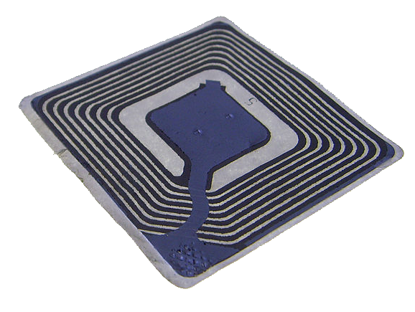
RFID Tags
Passive tag:
Paper type
Cheaper
Does not require power supply
Compact
Frequency of Operation:
125 kHz to 135 kHz
Range: 10 cm
Working Principle:
Inductive coupling (Near field coupling)

Slide 13
RFID Tag
Memory
Controller
Rectifier Circuit
Transponder
Notes:
Transponder: receives radio waves and sends the feedback, and get the energy from the waves comes from the reader, the rectifier circuit stores the energy across the capacitor, and this energy used as supplier for the controller as well as the memory

Slide 14
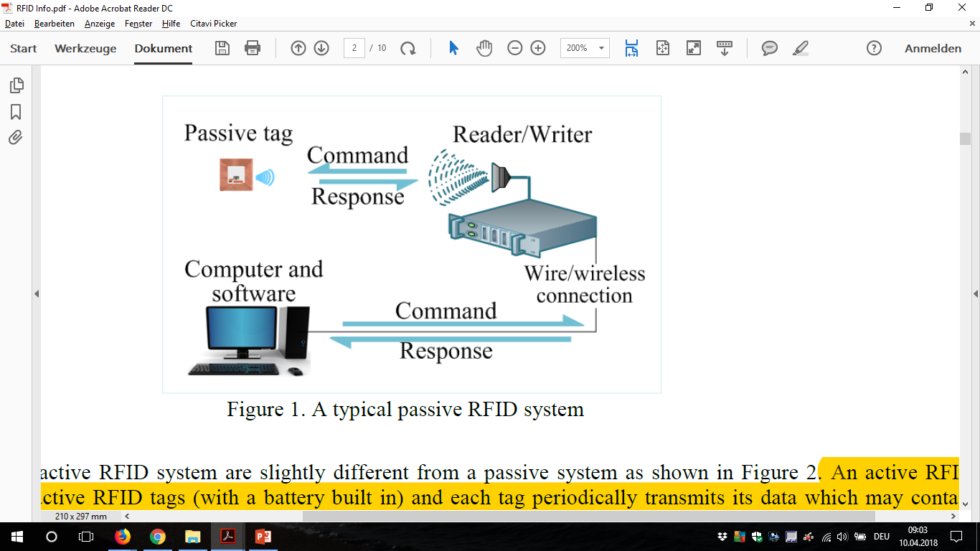
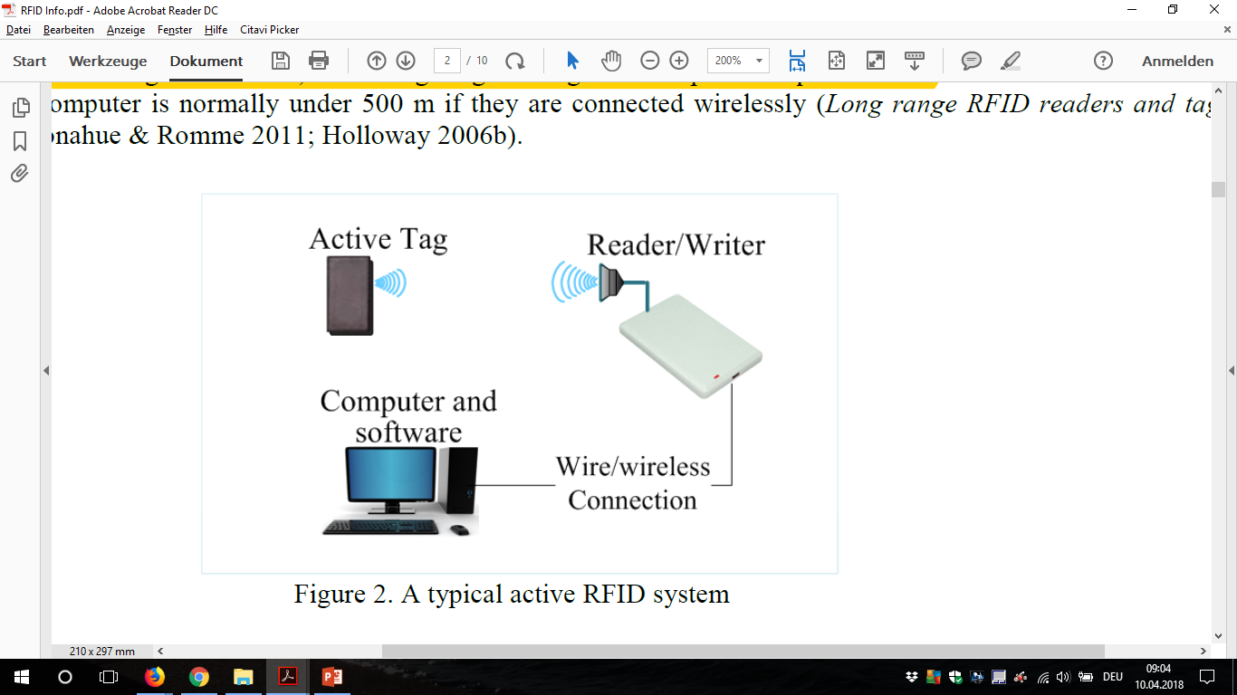
Plant Setup
Passive Active
Power for the passive tag is provided by the reader
Active systems can simultaneously read several tags and its reading range is longer

Slide 15
Implementation in our project
System 1 System 2
3 reader 1 reader at robot
1 active tag at robot many passive tags
Notes:
Using

Slide 16
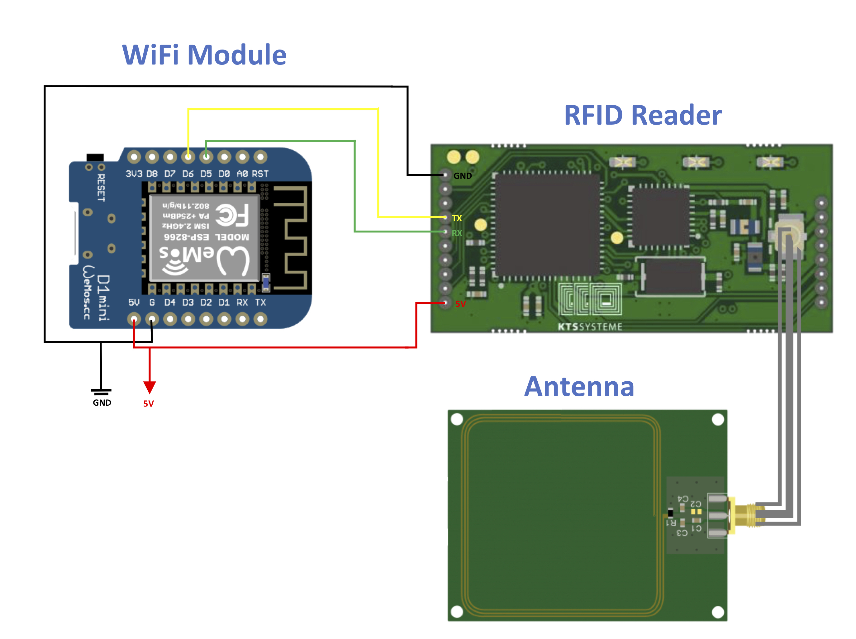
Hardware Setup

Slide 17
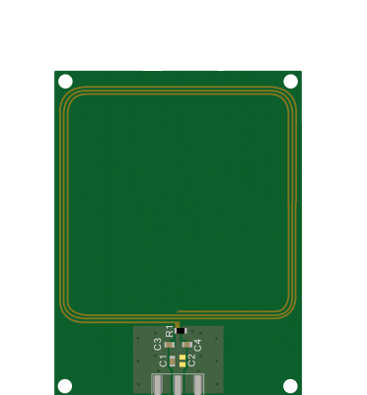
Hardware Setup

Slide 18
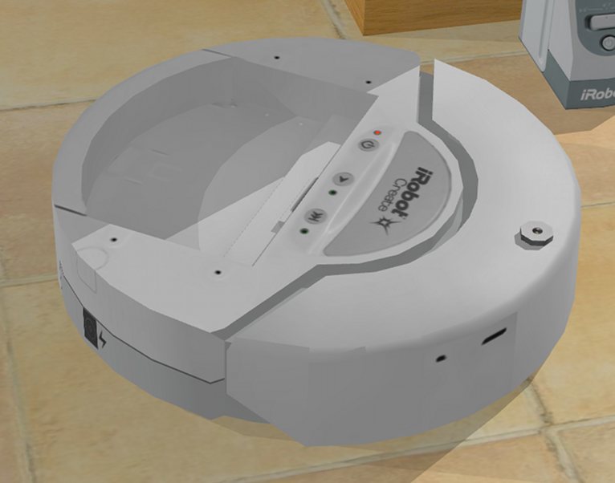
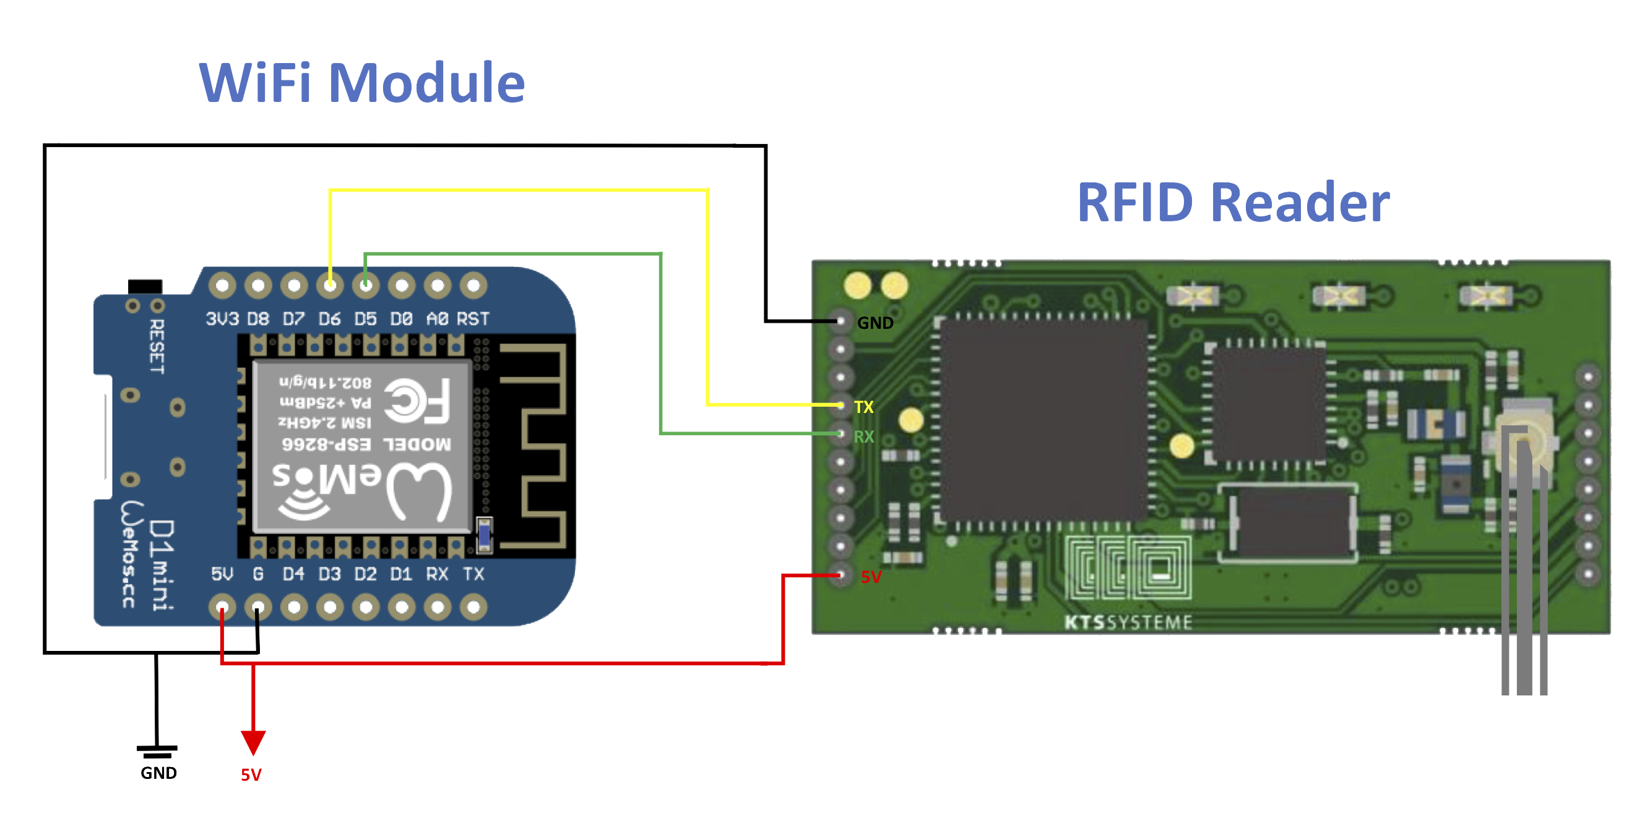
Hardware Setup

Slide 19
Simulation
Develop an emulator in Matlab to create a text file with RFID reader data
Inputs:
Size plant [1x1m]
Robot position + properties
Reading ranges [0-10cm]
Distance between the tags [10cm]
Number of measurements for each 360°turn (Init Proc)
Output:
Timestamp/orientation of robot
Found UIDs
Related RSSI [0...7]

Slide 20
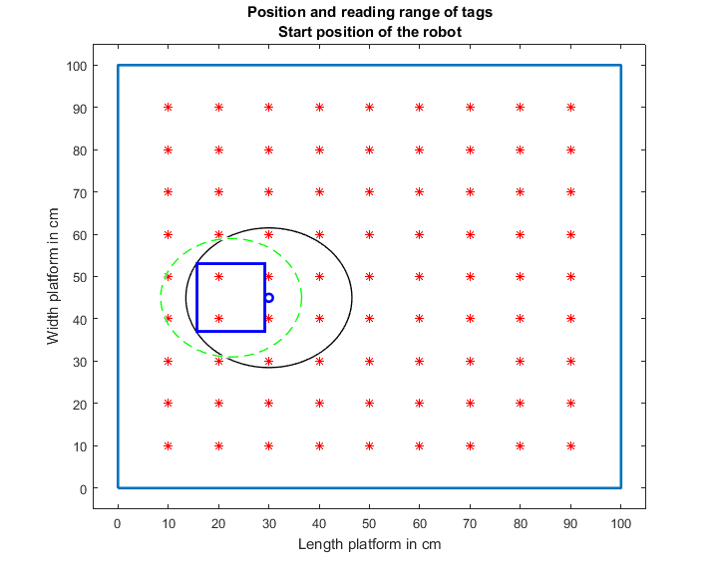
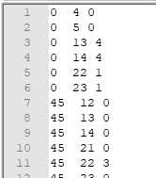
Emulator
Robot center o , dimension o
Position of the antenna ,Tags *
Max reading range of the antenna --

Slide 21
Simulation update
For own measurements: inconsistence between RSSI and distance tag and reader
Notes:
Order. circle

Slide 22
Possible reasons blind spot
The field and the inductor of the tag are perpendicular
Antenna
1.5 cm
Tag

Slide 23
Simulation results with emulated data
Run the code (next chapter) to estimate the initial pose with the emulated data
Without inconsistence (data from paper):
Error in X,Y-Position: 0.2 cm
Error in orientation: < 1°
After the update (with blind spot):
Error in X, Y-Position: 1.0 cm
Error in orientation: 20°

Slide 24


Software Implementation
Reader
WiFi-Module
Receiving()
RX
TX
TX
RX
Initialization()
MPC()
Position()
Orientation()

Slide 25
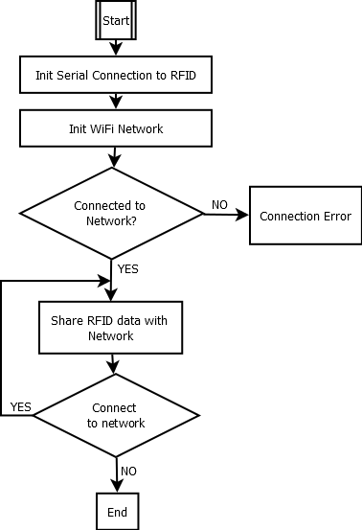
Sending()

Slide 26
Software Implementation
SCAN:+UID=xxxxxxxxxxxxxxxx,+RSSI=x/x
Reader
WiFi-Module
Receiving()
RX
TX
TX
RX
Initialization()
MPC()
Position()
Orientation()

Slide 27
Receiving()
New TCPClient(192.188.0.100, 8883);
Establish connection to WiFi module
New Streamreader()
As long as information from reader exists reading what RFID module sends:
SCAN:+UID=E00401503A5BD691,+RSSI=0/0
SCAN:-UID=E00401503A5BDAE4,+RSSI=4/4

Slide 28
Receiving()
Filter bad readings by “-”
Split string at “OK”, ”\r”, “\n”, “SCAN+UID=“, “RSSI=“
Convert UID from hex to dec and separate from RSSI
SCAN:+UID=E00401503A5BD691,+RSSI=0/0
E00401503A5BD691 0/0
1681 0/0

Slide 29
Software Implementation
SCAN:+UID=E00401503A5BD691,+RSSI=0/0
Reader
WiFi-Module
Receiving()
RX
TX
TX
RX
1681 0/0
Initialization()
MPC()
Position()
Orientation()

Slide 30
Initialization()
Why is a Initialization necessary?
Initialization procedure

Slide 31

Why is a Initialization necessary?

Slide 32
Why is a Initialization necessary?

Slide 33
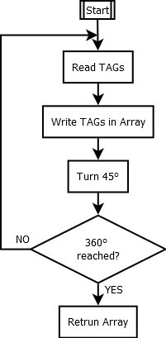
Initialization Procedure
ID1 | ID2 | ID3 | ID4 | ID5 | ID6 | ID7 | ST1 | ST2 | ST3 | ST4 | ST5 | ST6 | ST7
4 | 1 | 5 | 2 | 3 |  |  | 0 | 0 | 1 | 7 | 0
5 | 3 |  |  |  |  |  | 2 | 3
3 | 5 |  |  |  |  |  | 2 | 2
9 | 8 | 6 | 5 |  |  |  | 1 | 1 | 1 | 2
9 | 7 | 8 | 6 | 4 | 5 |  | 2 | 0 | 6 | 0 | 0 | 2
4 | 7 | 5 | 8 |  |  |  | 0 | 2 | 3 | 3
5 | 4 | 7 | 8 | 1 |  |  | 2 | 5 | 0 | 0 | 0
2 | 4 | 1 | 5 |  |  |  | 0 | 2 | 2 | 0

Slide 34
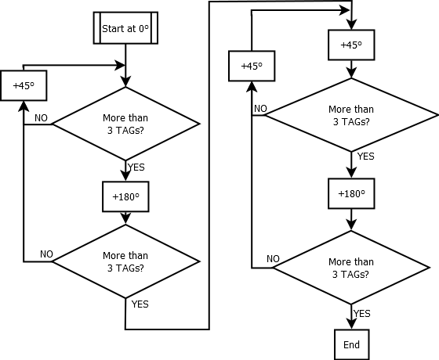
Analyzing Initialization Array[8,14]
ID1 | ID2 | ID3 | ID4 | ID5 | ID6 | ID7 | ST1 | ST2 | ST3 | ST4 | ST5 | ST6 | ST7
4 | 1 | 5 | 2 | 3 |  |  | 0 | 0 | 1 | 7 | 0
5 | 3 |  |  |  |  |  | 2 | 3
3 | 5 |  |  |  |  |  | 2 | 2
9 | 8 | 6 | 5 |  |  |  | 1 | 1 | 1 | 2
9 | 7 | 8 | 6 | 4 | 5 |  | 2 | 0 | 6 | 0 | 0 | 2
4 | 7 | 5 | 8 |  |  |  | 0 | 2 | 3 | 3
5 | 4 | 7 | 8 | 1 |  |  | 2 | 5 | 0 | 0 | 0
2 | 4 | 1 | 5 |  |  |  | 0 | 2 | 2 | 0

Slide 35
Software Implementation
SCAN:+UID=E00401503A5BD691,+RSSI=0/0
Reader
WiFi-Module
Receiving()
RX
TX
TX
RX
1681 0/0
Initialization()
Array[8,14]
MPC()
Position()
Orientation()

Slide 36
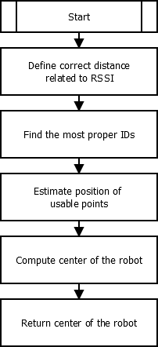
Initial position & orientation
Recorded array
ID1 | ID2 | ID3 | ID4 | ID5 | ID6 | ID7 | ST1 | ST2 | ST3 | ST4 | ST5 | ST6 | ST7
4 | 1 | 5 | 2 | 3 |  |  | 0 | 0 | 1 | 7 | 0
5 | 3 |  |  |  |  |  | 2 | 3
3 | 5 |  |  |  |  |  | 2 | 2
9 | 8 | 6 | 5 |  |  |  | 1 | 1 | 1 | 2
9 | 7 | 8 | 6 | 4 | 5 |  | 2 | 0 | 6 | 0 | 0 | 2
4 | 7 | 5 | 8 |  |  |  | 0 | 2 | 3 | 3
5 | 4 | 7 | 8 | 1 |  |  | 2 | 5 | 0 | 0 | 0
2 | 4 | 1 | 5 |  |  |  | 0 | 2 | 2 | 0

Slide 37
Inconsistence RSSI <-> Distance
Define the multiple distances related to one RSSI as:
Max, middle and min
RSSI | 0 | 1 | 2 | 3 | 4 | 5 | 6 | 7
Distance in [cm] | 14 | 9.75 | 9 | 8 | 7 | 6 | 3.5 | 2.75 | Max
Distance in [cm] | 5 | 5.1 | 5.3 | 5.5 | 5.8 | 4 | - | - | Middle
Distance in [cm] | - | 4.7 | 4.5 | 4.3 | 4.2 | - | - | - | Min

Slide 38
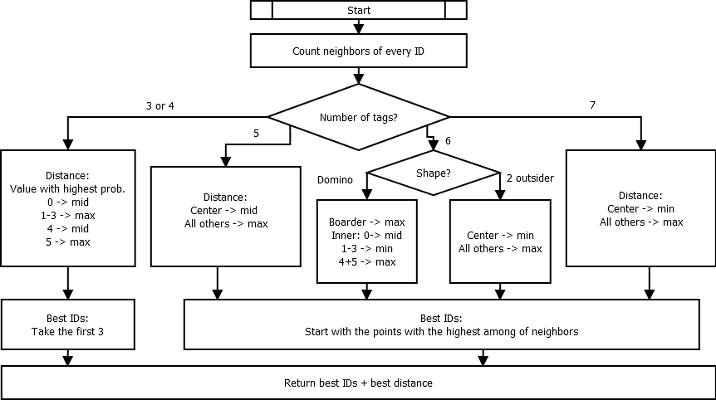
Best 3 + correct distance

Slide 39
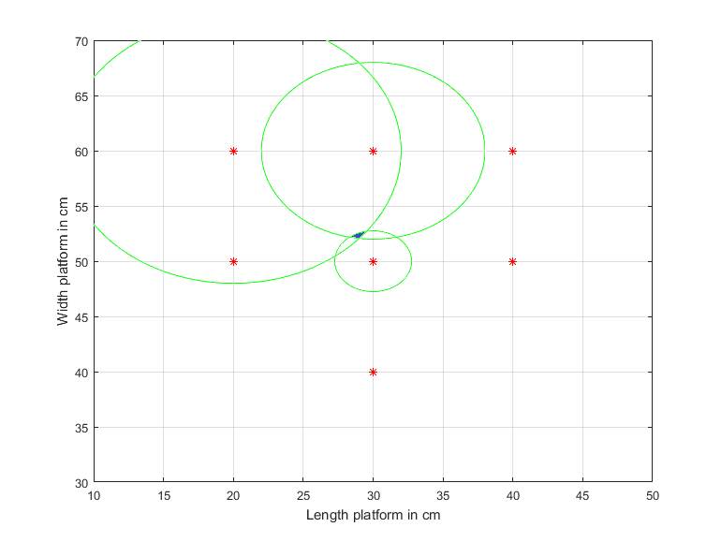
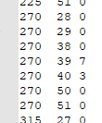
Trilateration
Using 3 defined positions + 3 radii to estimate the intersection point
Example
7 tags found
r₂
r₃
r₁

Slide 40
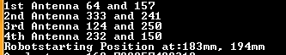
Compute centre of robot
The intersection can easily be computed with the help of the four coordinates
Output of the console:
x₁,y₁
x₈,y₈
x, y
x₄,y₄
x₅,y₅

Slide 41
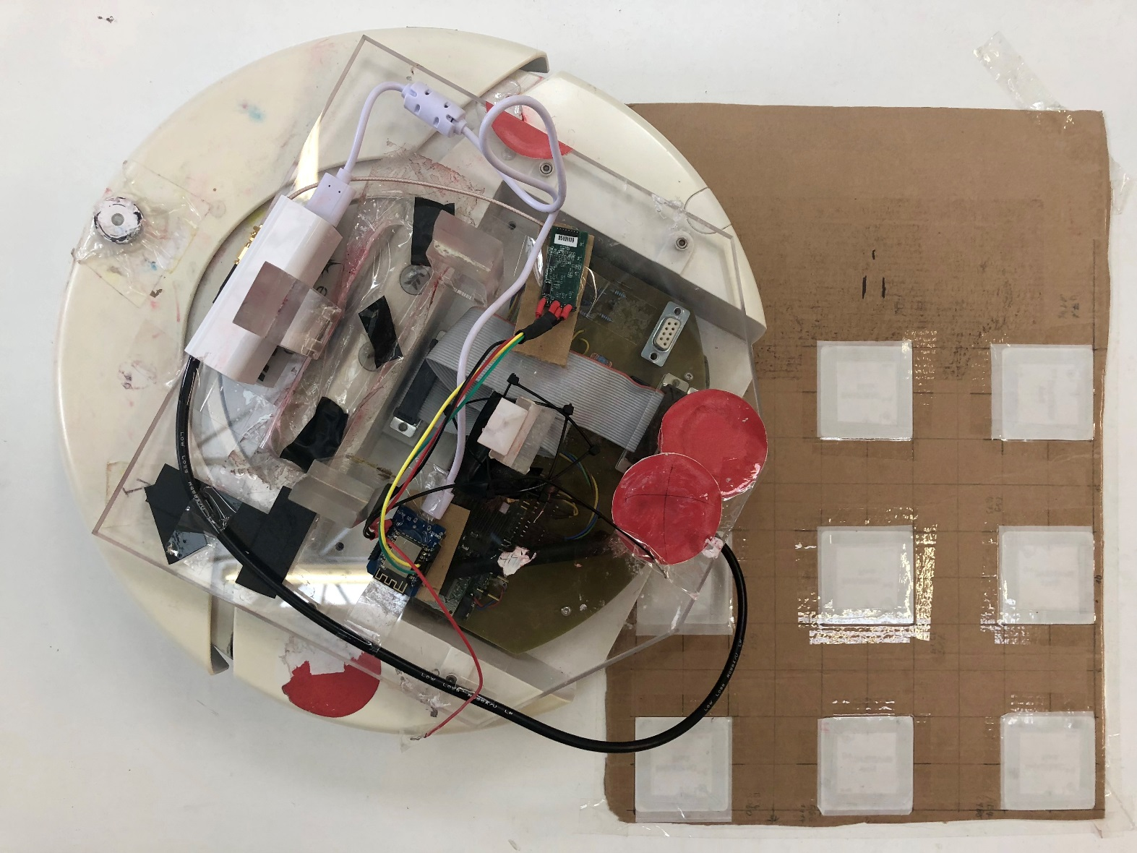
Initialization Procedure

Slide 42
Initialization Procedure
Video!!

Slide 43


Conclusion
Pick alternative Positioning System
Evaluate, compare and develop proof-of-concept
Ultimate goal: improve positioning precision
Light independence
No area limitations
Improved Accuracy good light condition
Improved Accuracy bad light condition
Improved Processing Time
Notes:
Include data abt the accuracy !!

Slide 44
Future Work
Hardware
Use local power supply of the robot
Include 15V to 5V converter
Add more the TAGs on an extended plant model
Add RFID modules to all robots
Software
Initialization turn based on more accurate parameter than time.
Encoders of the robot
Delete unused camera modules in the code
Optimize the localization algorithm

Slide 45
Thank you for your attention!

